Slide 1
Jenkins & GitHub Configuration with Parameters

Slide 2
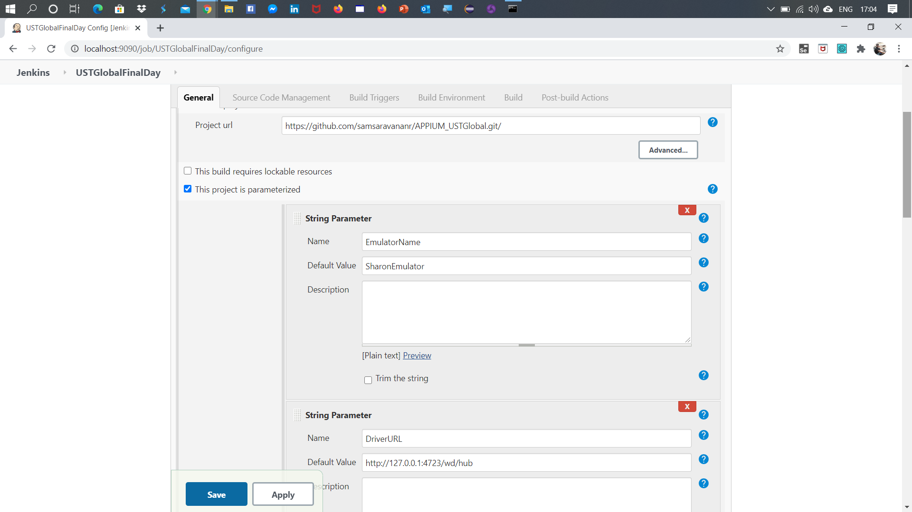
GitHub Project URL and String Parameters

Slide 3
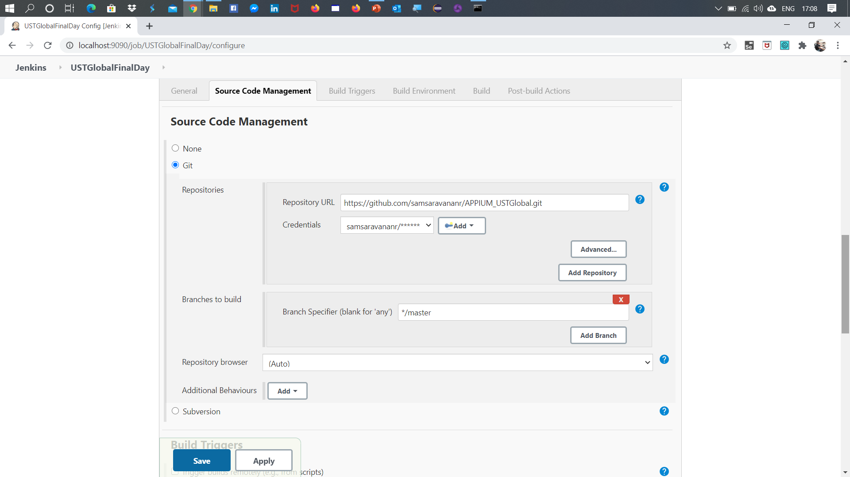
Source Code Management with Git

Slide 4
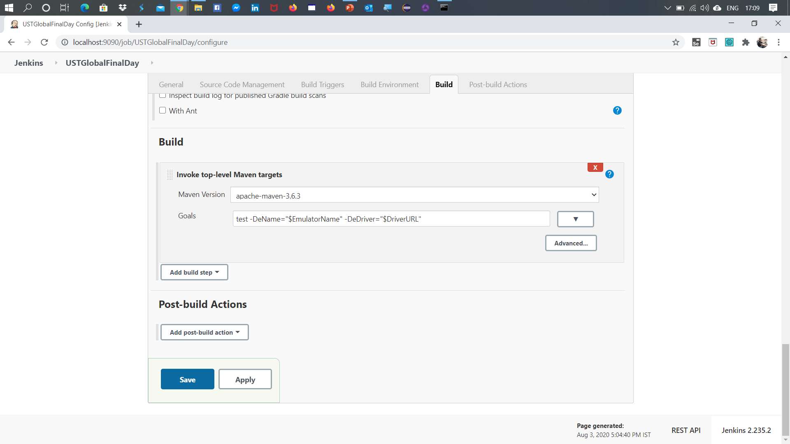
Maven Goals in Jenkins

Slide 5
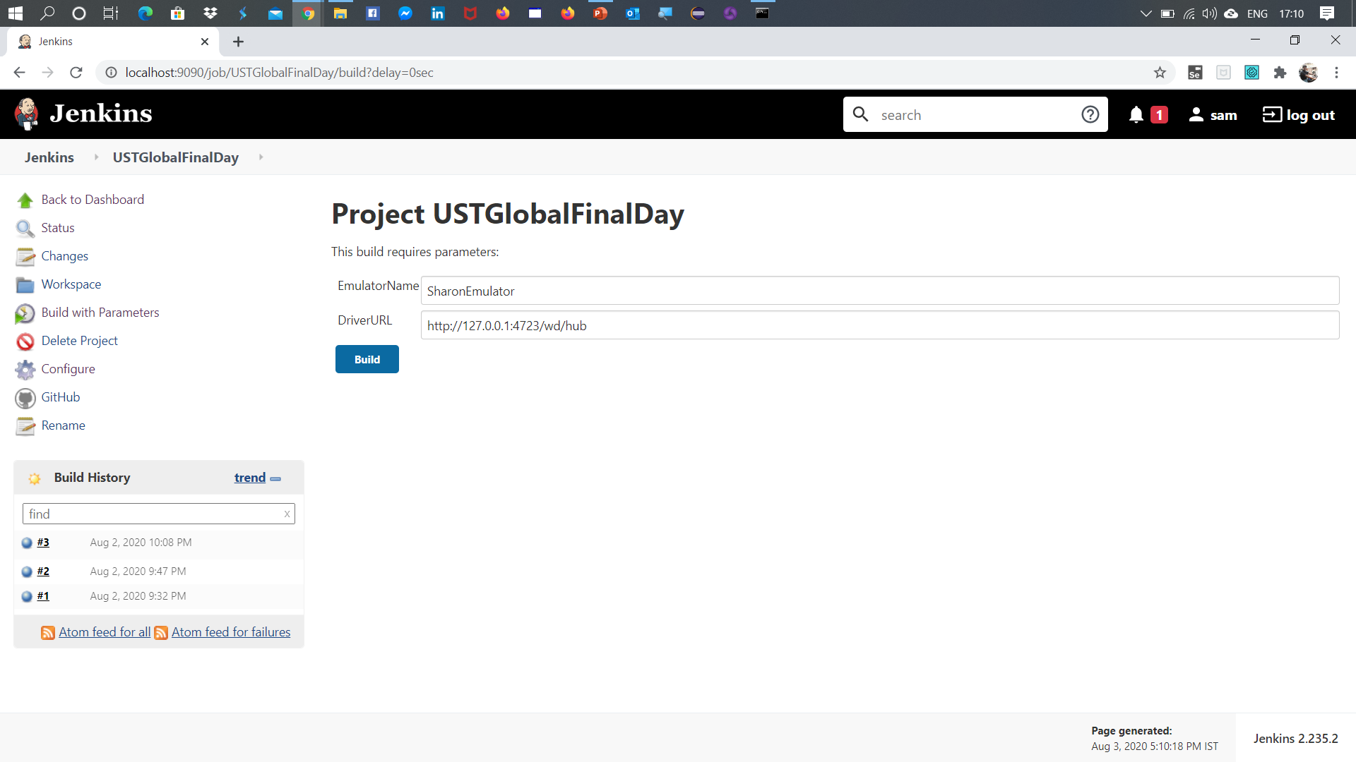
Build Jenkins with Parameters

